Slide 1

Adamas University
Mini Project
Automatic Room Light Controller Using Arduino And PIR Sensor
Presented by:
Pratik Das UG/02/BTEE/2018/003
Sachin Biswas UG/02/BTEE/2018/004
Rakesh Kumar Mishra UG/02/BTEE/2018/007
Arunabha Sarkar UG/02/BTEE/2018/011
Aditi Biswas UG/02/BTEE/2018/017

Slide 2
Table of content
Abstract
Image of the project
Overview
Aim
Components required
Specification of Components
Software used
Circuit diagram
Code
Explanation of Code
Working of the system
Application
Future Scope
Conclusion
References

Slide 3
Abstract
Automatic room light control system using Arduino and PIR sensor can be used to turn ON and OFF the lighting system of home or office automatically by detecting the presence of human.
System can be used in Garages, Staircase, Classroom, Faculty Cabin, Lift lobby, Bathrooms etc.
No need to worry about the electricity bills as the light get OFF when there is no human.
Automatic room light control system which is a part of home automation saves electricity power consumption.

Slide 4
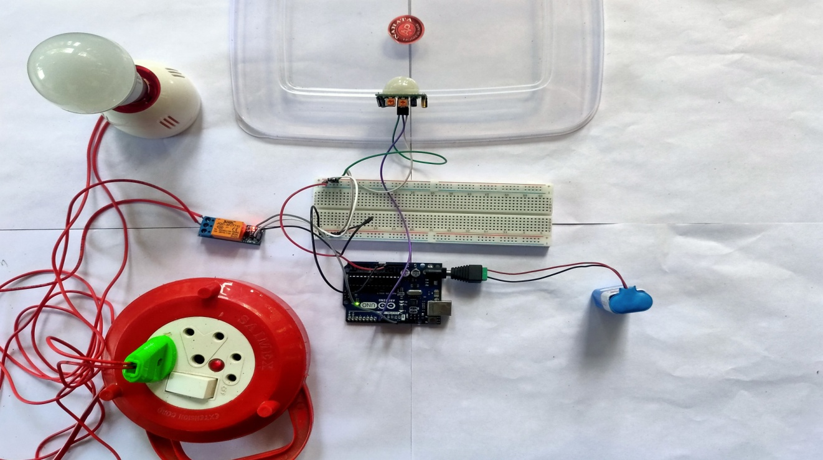
Image of the project Automatic Room Light Controller Using Arduino And PIR Sensor

Slide 5
Overview
Very useful project as we need not to worry about turning on and off the switches every time.
Main components of the project are Arduino, PIR Sensor and the Relay Module.
PIR Sensor is the main device that helps in detecting human motion.
This project can be considered as one major application of the PIR Sensor.

Slide 6
Aim
To build a device that the light in room will be automatically turned on upon detecting a human motion and stay turned on until the person has left or there is no motion
Flowchart of the System:
yes No
start
Detection by PIR sensor
Huma-n Presen-ce
Light ON
Light OFF
Stop

Slide 7
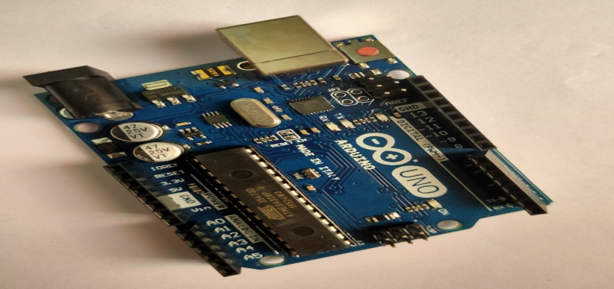
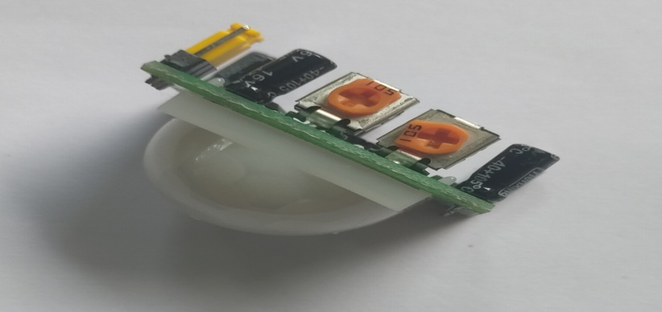
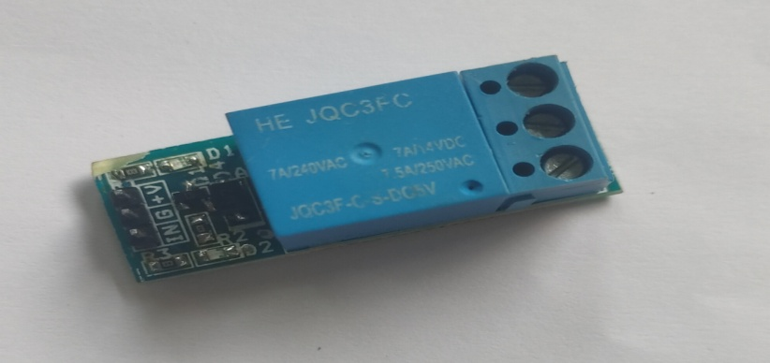
Components required
Arduino UNO
PIR sensor
5v Relay Module
9 Volt DC Battery
Jumper wires
Breadboard
AC LED Bulb
Bulb Holder
AC Power supply

Slide 8
Specification of the components:
Sl. No. | Name of component | Quantity | Specification
1 | Arduino UNO | 1 | Microcontroller: Microchip ATmega328p, Operating voltage: 5V, Digital I/O pins:14, Analog Input Pins:6
2 | PIR Sensor (HC-SR501) | 1 | 4.5-20V, <50µA, Sensing range:<120°, within 7m
3 | Single channel Relay Module | 1 | Voltage: 5V, Max. switching voltage:250V AC/30V DC, Max switching current: 10A
4 | AC LED Bulb | 1 | 9W,220-240V AC, Base Type: B22
5 | Breadboard | 1 | 400 points
6 | Jumper wire | 8 | Male to Male, Male to Female
7 | Lithium Battery | 1 | 9V DC
8 | Bulb Holder | 1 | Base type: B22

Slide 9
Software used
Software used to control this system is Arduino IDE (Integrated Development Environment).

Slide 10
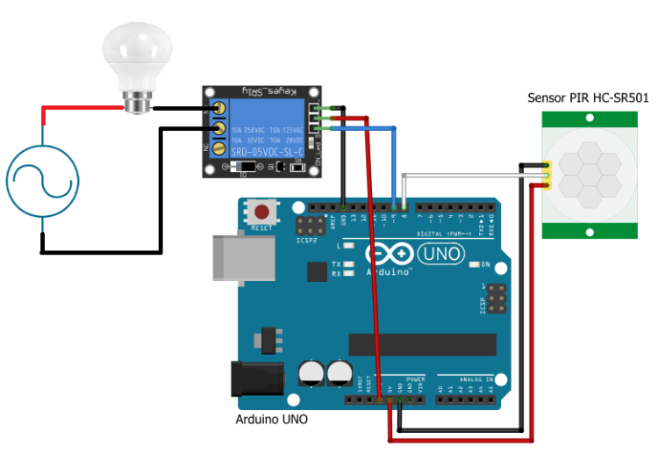
Circuit Diagram

Slide 11
Code
int sensor_pin = 8; // Initialized the pin for PIR sensor int relay_pin = 9; // Initialized the pin for Relay module
int output = 0; // variable for reading the pin status
void setup() {
Serial.begin(9600);
pinMode(sensor_pin, INPUT); //Declared the PIR sensor pin as Input pin
pinMode(relay_pin, OUTPUT); // Declared the Relay module pin as Output pin
}
void loop(){
output = digitalRead(sensor_pin); // Read the output state of PIR sensor
// If output is High
if( output==1) {
digitalWrite(relay_pin,LOW); // Turn ON the lamp
}
// If output is Low
else {
digitalWrite(relay_pin,HIGH); // Turn OFF the lamp
}
}

Slide 12
Explanation of Code
We have initialized the pins where we have connected the PIR motion sensor and Relay module. Then we have initialized a variable name “output”.
In the setup function, we have declared the PIR sensor pin as input pin and we have declared the Relay pin as output pin.
In the loop function, we have read the output of the PIR sensor and checked that whether the output is HIGH or LOW. If the output is HIGH, then the Relay will be turned on and if the output is LOW, then relay will be turned off.

Slide 13
Working of the system
Working of this project is very simple and is explained here :
When there is no human movement, the PIR Sensor doesn’t detect any person and its OUT pin stays LOW. As the person enters the room, the change in infrared radiation in the room is detected by the PIR Sensor.
Output of the PIR Sensor becomes HIGH. Arduino will activate the Relay.
This will turn the light ON. The light stays turned ON as long as there is human movement in front of the sensor.
If there no human movement infront of the PIR Sensor, the IR Radiation will become stable and the Data OUT of the PIR Sensor will become LOW. Arduino will turn OFF the Relay and the room light will be turned OFF.

Slide 14
Applications
Application areas of this project are:
Garage Light
Bathroom Light
Staircase Light
Lift lobby Light

Slide 15
Future scope
Interfacing LDR (Light Dependent Resistor) along with PIR sensor for better working of the system.
Interfacing with the Bluetooth module for controlling the system from mobile.

Slide 16
Conclusion
Approach is taken to control the room lights using various devices.
Energy wastage can be reduced.
Effective cost of system is very less.

Slide 17
References
Jaeseok Yun and Sang-Shin Lee, “Human Movement Detection and Identification Using Pyroelectric Infrared Sensors” Sensors 2014
Subitha M.B “Microcontroller based tracking system for the detection of Human presence in critical Areas” vol.2, Issue 4, IJEDR 2014
Karthikeyan.R.A, Saran Sriram K, Piyush.D “Automatic Lighting Using Arduino and PIR Sensor”, International Journal of Computer Science Trends and Technology, Volume 6, Sept-Oct 2018.

Slide 18
Demonstration
Link :
https://riceindia-my.sharepoint.com/:v:/g/personal/arunabha_sarkar_stu_adamasuniversity_ac_in/EUCtwDU9GWRBhUlJ8A3bSeEBv1DIoDg3xbC6wixlPcKkZg?e=BJpPdJ

Slide 19


